Slide 1



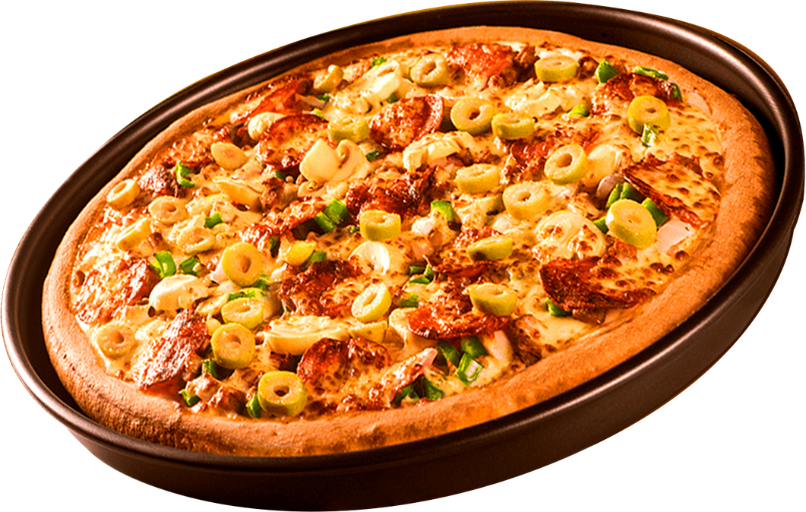


vishalkumar
Home
About
Contact
DATA ANALYSIS PROJECT ON PIZZA HUT SALES
SQL
Project
Uncovering Business Insights from Real-World Data
Vishal Kumar
BBA Student | Aspiring Data Analyst
2025 Project

Slide 2
Home
About
Contact
THIS PROJECT INVOLVES ANALYZING PIZZA HUT ORDER DATA USING SQL
Identify sales trends across locations and time
Understand customer preferences and order patterns
Find peak hours, top-selling items, and low-performing categories
Generate insights that can support better decision-making in marketing, inventory, and customer service
SQL
Project

Slide 3




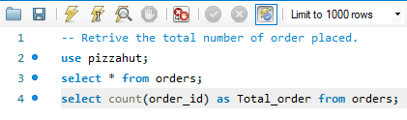
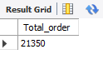
RETRIVE THE TOTAL NUMBER OF ORDER PLACED

Slide 4
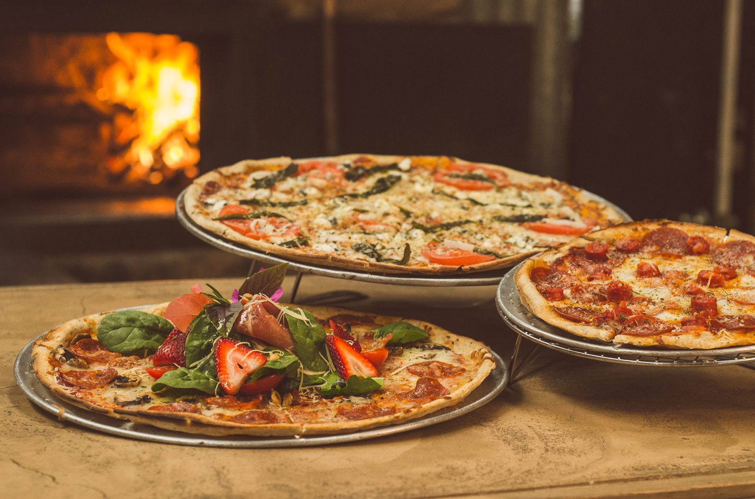
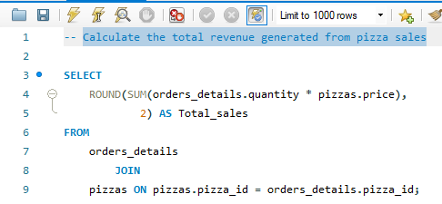
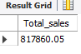
CALCULATE THE TOTAL REVENUE GENERATED FROM PIZZA SALES

Slide 5
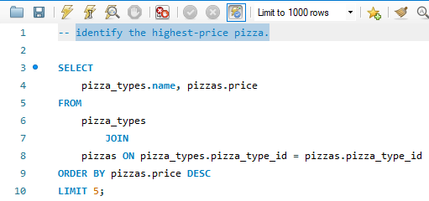

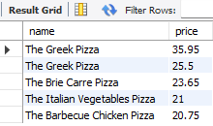
IDENTIFY THE HIGHEST-PRICE PIZZA

Slide 6
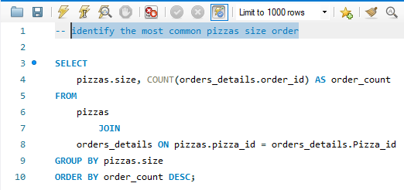

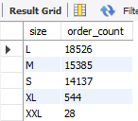
IDENTIFY THE MOST COMMON PIZZAS SIZE ORDER

Slide 7
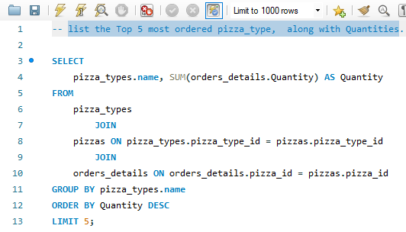

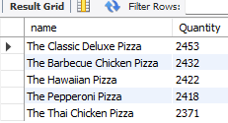
LIST THE TOP 5 MOST ORDERED PIZZA_TYPE, ALONG WITH QUANTITIES

Slide 8
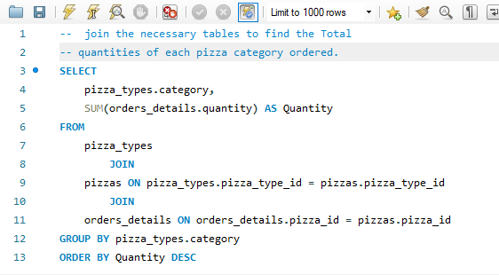
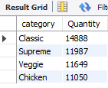



JOIN THE NECESSARY TABLES TO FIND THE TOTAL QUANTITIES OF EACH PIZZA CATEGORY ORDERED.

Slide 9
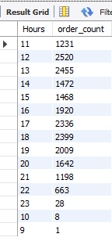
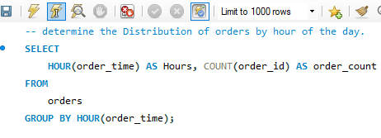
DETERMINE THE DISTRIBUTION OF ORDERS BY HOUR OF THE DAY.

Slide 10
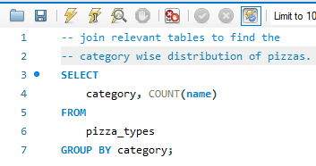
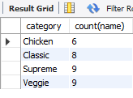
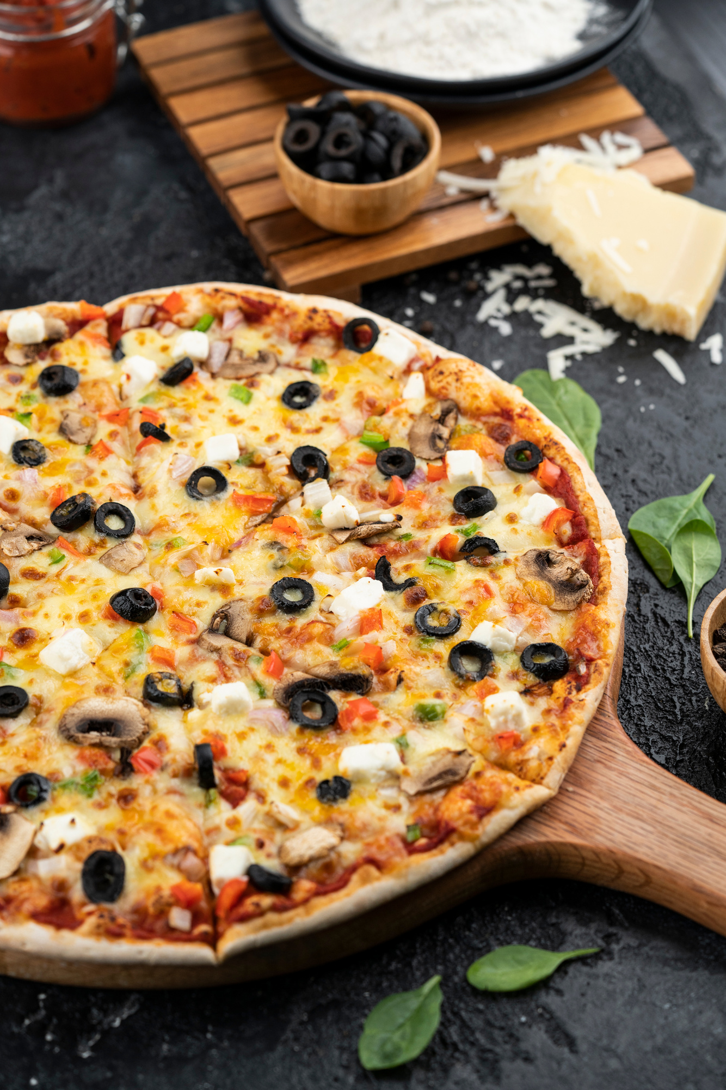
JOIN RELEVANT TABLES TO FIND THE CATEGORY WISE DISTRIBUTION OF PIZZAS.

Slide 11
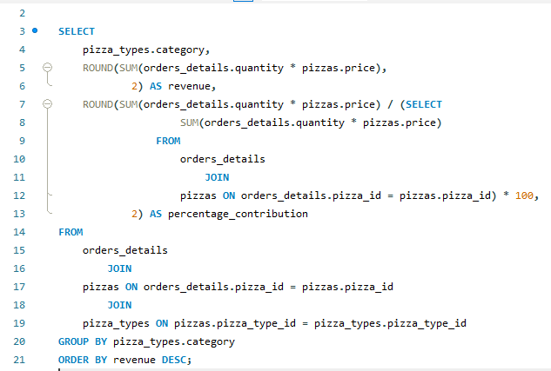
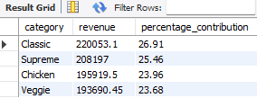
CALCULATE THE PERCENTAGE CONTRIBUTION OF EACH PIZZA TYPE TO TOTAL REVENUE

Slide 12
VISHAL KUMAR
Home
About
Contact
THANK YOU
THANK YOU FOR YOUR TIME AND ATTENTION
vishalnefkumar@gmail.com

